Slide 1
FinXperience Consumer Portal

Slide 2
Contents
Test Goals
Application Under Test
Test Approach
Defect Management
Gate Criteria
QA Metrics
Test Tools
Communication Plan

Slide 3
Test Goals
Ensure Quality of Consumer Portal Applications and Interfaces
Traceability
Requirements to Test Cases
Test Cases to Iterations
Defects to User Story and Test Cases
Feedback
Metrics
Recommendations

Slide 4
Application Under Test
Tavant FinXperience is designed to provide Omnichannel Digital Mortgage Experience to Borrowers, Loan Officers, Brokers, Correspondents. It gives fastest turnaround time for business transactions with personalized user experience during every step in the process
Scope :
<Provide path>
Out of Scope:

Slide 5
Project Phases – QA Activities
Release
Week | Wk1 | Wk2 | Wk3 | Wk4 | Wk(n) | Wk(n) | Wk (n) | Wk (n)
Milestone | Layer 1
Sprint | Sprint 1 |  | Sprint 2 |  | Sprint N |  | System testing | UAT
Tasks | Requirement Walkthrough and analysis of Sprint 1 user stories STC Authoring of Sprint 1 ATC Execution of Sprint 1 STC Execution of Sprint 1 |  | Requirement Walkthrough and analysis of Sprint 2 user stories STC Authoring of Sprint 2 ATC Execution of Sprint 2 STC Execution of Sprint 2 5. Defect Verification Automation test scripting of Sprint 1 Automation script execution of Sprint 1 |  | Requirement Walkthrough and analysis of Sprint N user stories STC Authoring of Sprint N ATC Execution of Sprint N STC Execution of Sprint N Defect Verification Automation test scripting of Sprint N-1 Automation script execution of Sprint N-1 |  | Regression testing of all ATC's and functional STC's of Sprint 1 to N Defect Verification Performance & Security testing | Verification & regression around UAT defect fixes

Slide 6
Iteration/Release
Week 1
Week 2
Day 1
Day 2
Day 3
Day 4
Day 5
Day 6
Day 7
Day 8
Day 9
Day 10
Sprint Planning Meeting & grooming 2
Automation scripting of previous sprint
Automation Script execution of previous sprints
Automation script review & rework
Defect reporting
Tavant QA - Test Authoring Activities
Requirement Analysis & Clarifications
Test Case Preparation
Test Case Review & Rework
ATC & STC Test Execution (To be performed in QA environment)
Defect Reporting
PO Team Review and Signoffs
Sprint Scope Signoff
Test Case Signoff
Defect Review
Readiness Review
Sprint QA Sign off
Agile Methodology - QA

Slide 7
Test Approach: Test Planning
Strategy and Planning:
Prepare Test Plan. Master Test Plan (covering all the releases in scope) of project using the Tavant Test plan template will be prepared and modified on need basis
Review Test Plan with Approvers
Baseline Test Plan
Deliverables:
Approved Test Plan
Effort Estimation:
Capacity Planning – QA estimates its capacity allocates QA resources to an iteration until all resources are exhausted.
Deliverables:
Approved Test Estimate

Slide 8
Test Approach: Test Authoring
Test Case Preparation:
The Tavant QA team prepares the Smoke/System Test cases using the Acceptance test cases of each Sprint, Field Matrix, Role Matrix, Wireframes etc.
The test cases will be authored using the test management tool TFS
Two tier Review of test cases will be performed by the Tavant QA Lead and BA counterpart respectively. Review Report will be prepared .
Approved System test cases/scenarios are baselined for execution.
Approved System test cases/scenarios are stored in TFS.
Deliverables:
Approved Smoke Test cases
Approved System Test cases

Slide 9
Test Approach: Test Execution
Test Execution:
Sprint Testing Phase: In every Sprint,
Tavant QA team will execute the Acceptance Test Cases (ATCs) in the QA Environment
Smoke test cases will be executed in QA environment
The system test cases of the current sprint will be executed in QA environment
Defects will be logged and tracked in TFS.
System Testing Phase: During the System Testing, Tavant QA teams will concurrently execute the complete set of Acceptance and System Test Cases pertaining to the functionalities of all the sprints (in scope of that release) in QA environment, log and track defects. Testing follows a defect tracking, review (defect triage) and resolution process. Test Results and Defects will be maintained in TFS.
Defect Triage: The defects logged during the testing phase undergo an ongoing review by all stakeholders who are responsible for assigning priority defects. A defect triage meeting is scheduled with all the stake holders of the project. In this meeting the team reviews all the open defects raised by the testing team. A decision on fixing these defects is taken in consultation with the producers based on the Priority.
Deliverables:
Approved/Reject build to QA/Staging
Bug Reports (TFS)
System test execution reports
Status Report

Slide 10
Test Approach: Browser Compatibility Testing
Approach:
QA will perform browser compatibility testing on below mentioned OS and Browser configurations
Browser Configuration - Latest versions of Firefox and Chrome available at the end of release
QA identifies Key or Primary scenarios for Browser Compatibility Testing to ensure testing of all the screens and functionalities.
Review and Approval of Key scenarios identified as part of browser compatibility testing will be done by QA Lead.
The Browser Compatibility testing on all the browsers in scope is performed during System Testing iteration.
Deliverables:
Browser Compatibility Test Results

Slide 11
Test Approach: Device
Approach
QA will perform Device testing on below mentioned OS and Browser configurations based upon the identified scenarios for Device testing
Testing on different form factors will be done using the browser setting
Device testing will be performed on latest version of identified device
The Device Compatibility testing is performed during Hardening phase.
The devices mentioned will be utilized from Tavant Test Tab during our Device testing phase-
Deliverables:
Device testing results
DEVICE NAME | iPhone 6, iPhone 5S, iPad, Samsung S4/S5, Samsung TAB
OS | IOS , Android
BROWSER | Chrome, Safari
VERSIONS | Latest version of Chrome & Safari

Slide 12
Test Approach: Automation Testing
UI Automation
Using the FIRE automation framework, The Automation QA team will formally start developing and implementation of scripts once the manual test scenarios are reviewed and finalized.
Service Layer Automation
Using the in-house framework developed by the architect in the team, The Automation QA team will be developing the scripts once the scenarios are reviewed and finalized. The automation scenarios where API has been exposed will be automated.
Automation Demo & Sprint Signoff
The Automation demo will be provided to all the project stake holders on the last day of every sprint cycle. The stake holder’s feedback, review will be taken and considered for planning the next sprint activities.

Slide 13
Test Approach: Performance
Performance Testing:
Performance Testing is conducted to identify the behaviour and system performance for these parameters on certain defined workload:
Response Time
Hits/sec
Throughput
System Resource Utilizations
Performance Test tools will be identified by assessing the application technology stack and feasibility study
Performance testing activities will be starting from Sprint 9 onwards and detailed planning will be captured in Performance test plan.
Performance Testing Phase:
During this phase, test scenarios are identified by QA Lead based on User Stories and ATCs. Performance testing activities such as Performance Test Scripting, Test Execution and Performance Test Analysis will be conducted for key scenarios identified.
The volume of data and number of users are derived from business.
Permissible Response Time for pages with no third party integrations is expected to be 4 seconds

Slide 14
Test Approach: Performance
Deliverables:
Performance Test Plan
Performance Test Scenarios
Performance Test scripts of the identified scope
Performance test results
Test Environment:
Test environment for Performance testing needs to be identified. This environment should ideally be a replica of the production environment or the scaled down version of the current estimated Production environment
Test Data Preparation:
Load test data set-up will be required to perform load testing.
The load test environment considered for Performance testing should be an sandbox and an replica of production in terms of hardware sizing and also the test data availability equal to production volume.

Slide 15
Test Approach: Security
Security Test Environment and Test Data
Security testing will be starting from Sprint 4 onwards and detailed planning will be captured in Security test plan.
Once the application is stable and the environment is identified
Security Testing Phase:
During this phase, The security test analyst will identify the Security test requirements/scenarios and conduct automated and Manual penetration attacks, Security testing activities such as Security Test Scripting, Penetration testing and Test Analysis will be conducted for security test scenarios.
The volume of data and number of users are derived from business projections.
Note: OWASP top 10 vulnerabilities will be covered as part of Security testing.
Deliverables:
Security Test Plan
Security Test Scenarios
Security Test Report/ Traceability Matrix
Note: Test Plan Attached.

Slide 16
Production Support

Slide 17
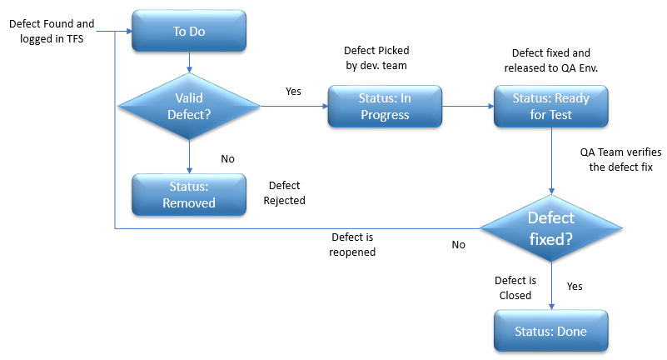
Defect Management
TFS will be used as Defect Tracking Tool. Testing would follow a defect tracking, review and resolution process.
.

Slide 18
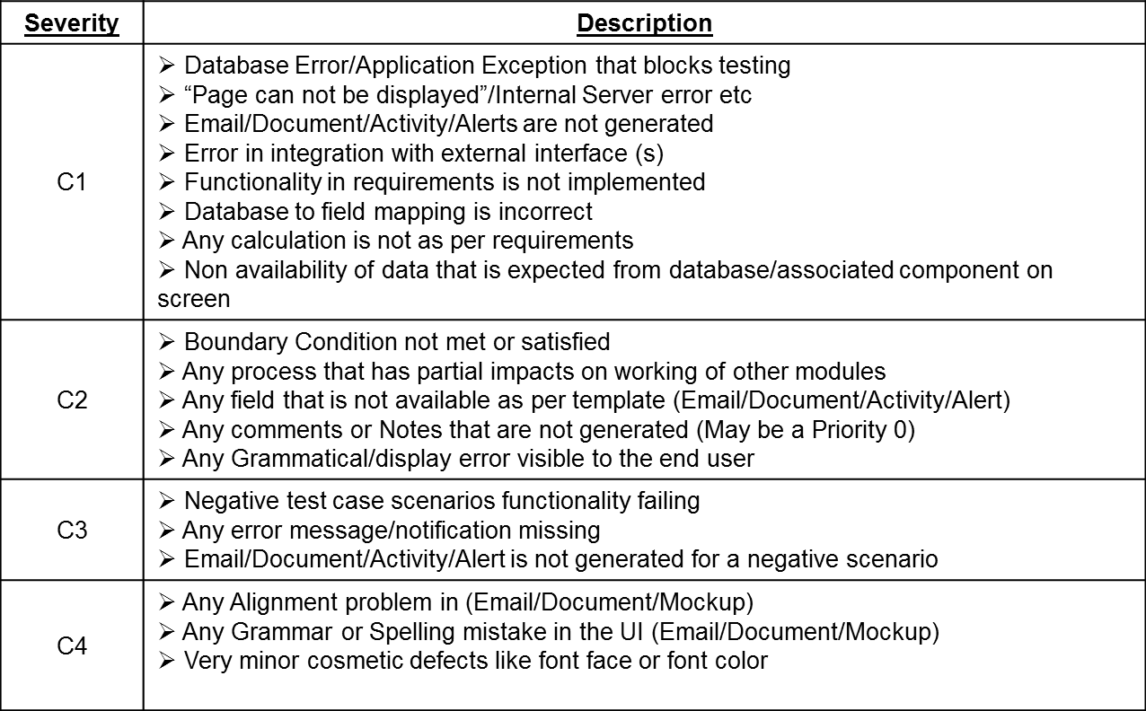
Defect Classification

Slide 19
Test Environment
Environment | Location | Advantages
QA | TBD | This environment will be used to perform the Acceptance testing And to perform the smoke testing, system testing and automated regression testing.
QA - Production support | TBD | This environment will be used for production support testing
Staging/UAT | TBD | This environment will be a Production-like environment, where the User Acceptance testing is performed by the Customer.
Production | TBD | Validation of the Production environment is performed by the Customer.

Slide 20
Gate Criteria
Test Planning Entry Criteria:
Approved scope for Iteration.
Test Authoring Entry Criteria:
Test Plan reviewed and approved
Approved requirements artefacts.
Test Execution Entry Criteria:
Acceptance test cases has been Dev. Completed.
QA environment available and stable.
Test data is available and required access to DB and logs is available.
System Testing Entry Criteria:
All User stories of the release has been QA Completed.
Defect fixes during system testing deployed into QA environment based on build calendar.
QA environment available and stable.
Test data is available and required access to DB and logs is available.
System Testing Exit Criteria:
Smoke Test Results
Acceptance test cases has been QA Tested and Certified.
All planned System test cases/scenarios have been executed.
All Defects logged for the release are Closed or Deferred
Sign-off by Tavant QA

Slide 21
Test Data
QA uses test data files supplied by Development.
QA modifies the files, as needed, to create new test scenarios.

Slide 22
QA Metrics
Testing team performance Indicator Category | Description | Indicator | Unit of Measurement
Test Efficiency | This metrics quantifies the efficiency of the testing process | # of testing defects in Release/ (# of defects found in UAT + Prod (30 Days) + # of testing defects in Release) * 100 | Percentage
Coverage (ATC/STC) | This metric quantifies the amount of testing covered by a set of test cases during a particular iteration | Coverage = No. of coverage items exercised / Total No. of coverage items | Percentage
Root Cause Analysis | Analysis of all UAT and Production defects will be done at the end of the release
Bugs rejection Rate (Internal & External) | This metrics gives the No. of bugs re-opened by the QA and customer | (No. of bugs re-opened / Total No. of bugs delivered)* 100 | Percentage

Slide 23
Test Tools
Activity | Tools Used | Advantages
Requirement Issue Clarification Test Plan Test Management Defect Tracking & Management Configuration Management QA Project Plan & Schedule Automation Performance | TFS MS Word TFS TFS SharePoint TFS | A structured repository to maintain Requirement clarifications component wise. A document detailing the strategy that will be used to verify and ensure that a system meets its design specifications and other requirements Tool used to maintain Test Cases, Test Results Tool used to maintain Defects All relevant QA artifacts will be maintained in Tavant SharePoint. Tool used to plan & track QA tasks.

Slide 24
Communication Plan
Communication | Frequency | Purpose | Team Members
Daily Standup Meeting | Daily | Focuses on daily project status/blockers/risks | Scrum team – Offshore
Daily Status email | Daily | Contains the status on Authoring, Execution and defect reporting | Scrum team & Stake holders
Sprint Sign off email | Sprint | Contains the information on the user stories that are signed off as part of the sprint and the known issues/ dependencies | Scrum team & Stake holders
System testing Sign off email | Layer | Contains the information on the user stories that are signed off as part of the layer and the known issues/ dependencies | Scrum team & Stake holders

Slide 25
Thank You

